Slide 1
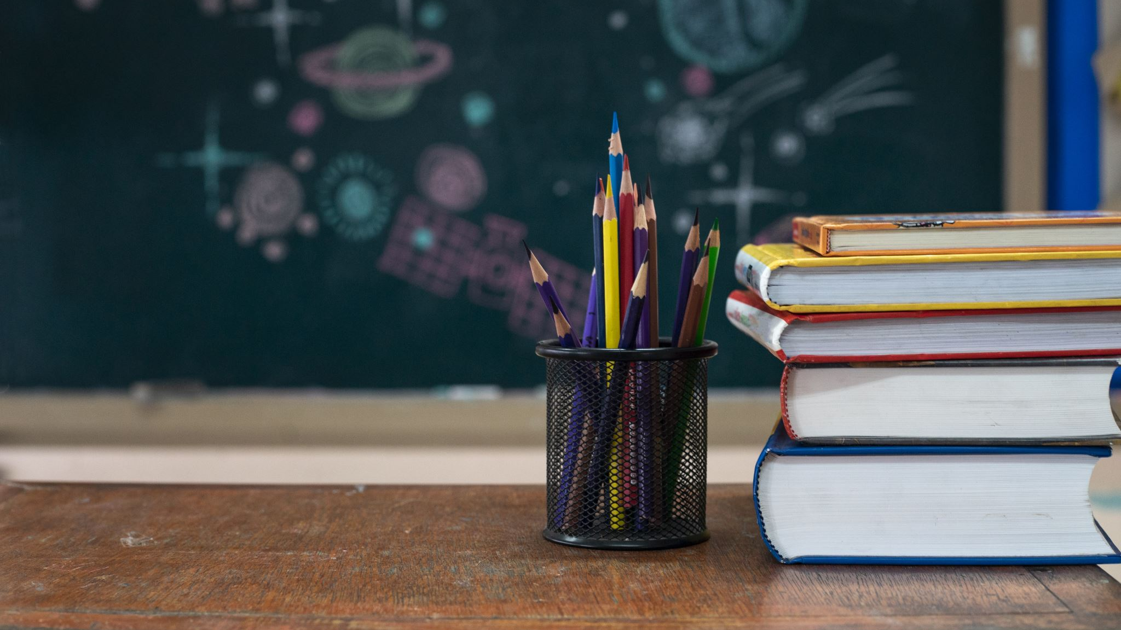
Creative Algebra: Engaging Students with Hands-On Learning Experiences
Frank Jamison
ITL522: Content Area Literacy
Professor Barbara Ray
February 4, 2024

Slide 2

Active Learning Experiences in Algebra

Slide 3

Experience 1: Algebraic Expressions Art Gallery
Activity Description: Students will move around the room to different stations, each dedicated to a different algebraic expression or equation. At each station, they will use a variety of materials (colored paper, markers, string, etc.) to create a visual representation of the expression or equation. For example, they could build a physical model to represent the distributive property or create a collage that visualizes solving a two-step equation. This activity encourages students to think creatively about algebra and to see the connections between mathematical concepts and visual arts.
Product: Each student or group will contribute a piece to an "Algebraic Expressions Art Gallery" displayed in the classroom. This gallery will serve as a visual reference for algebraic concepts and promote a deeper understanding through artistic expression.

Slide 4
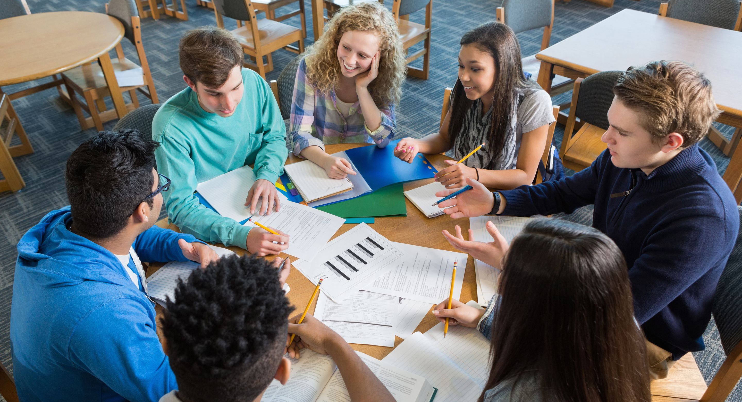
Experience 2: Equation Solving Race
Activity Description: Students are divided into teams and move between stations, each presenting a different type of algebraic equation to solve (e.g., linear equations, quadratic equations, systems of equations). At each station, they find materials to build the solution physically. For instance, using blocks to model and solve linear equations by balancing or creating a path through a maze that represents the steps to solve a quadratic equation. The race element adds excitement and encourages teamwork.
Product: The product is a series of solved equations documented in a team "race logbook," where each team records their solutions, strategies, and reflections on the challenges they faced. This logbook serves as a tangible record of their learning journey and problem-solving skills.

Slide 5
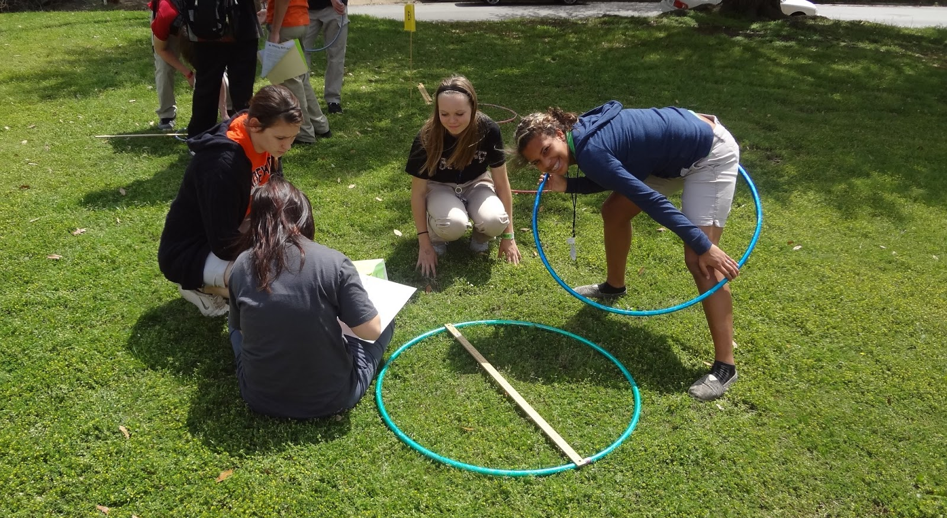
Experience 3: Algebraic Structures Construction Site
Activity Description: This station focuses on building an understanding of algebraic structures (like functions, graphs, and inequalities) using construction and engineering principles. Students use materials such as Lego, K'NEX, or cardboard to construct models that represent different algebraic structures. For example, constructing a roller coaster to understand the graph of a quadratic function or building a scale to explore inequalities.
Product: The product is a mini-construction project visually and physically representing an algebraic structure. Students will also prepare a brief presentation explaining their model, the algebraic concept it represents, and how the construction process helped them understand the concept better.

Slide 6

Writing Prompts for Each Learning Experience

Slide 7

Writing Prompt 1: Algebraic Expressions Art Gallery Reflection
Purpose: Reflective Writing
Prompt: "Reflect on the process of creating your algebraic expression art piece. How did transforming an algebraic concept into a visual format help you understand it better? What challenges did you face, and how did you overcome them?"

Slide 8

Writing Prompt 2: Equation Solving Race Analysis
Purpose: Analytical Writing
Prompt: "Analyze the strategies your team used during the Equation Solving Race. Which strategies were most effective and why? How did teamwork contribute to solving the equations, and what would you do differently next time?"

Slide 9

Writing Prompt 3: Construction Site Presentation
Purpose: Persuasive Writing
Prompt: "Prepare a presentation to persuade your classmates that your construction project accurately represents the assigned algebraic structure. Include explanations of the materials used, the design process, and how your model serves as a metaphor for the algebraic concept."

Slide 10

Inclusivity and Representation in Learning Experiences

Slide 11

Experience 1: Algebraic Expressions Art Gallery
Inclusivity & Representation: This activity allows students to express their understanding of algebraic concepts through art, accommodating diverse learning styles and encouraging creativity. By incorporating materials and examples that reflect a variety of cultures and perspectives, students see their identities and experiences represented in the curriculum. Student choice in artistic medium ensures that all students can engage in a way that feels accessible and meaningful to them.

Slide 12

Experience 2: Equation Solving Race
Inclusivity & Representation: Group work in this activity ensures that each student can contribute their strengths, whether in problem-solving, creative thinking, or physical construction. The variety of equations and problem-solving methods allows for different difficulty levels, ensuring that students of all skill levels can participate and feel challenged. By allowing teams to choose which stations to tackle, students have a voice in their learning path.

Slide 13

Experience 3: Algebraic Structures Construction Site
Inclusivity & Representation: This activity leverages tactile learning and spatial reasoning, providing an alternative to traditional algebra instruction that may better suit the needs of students with different learning preferences. Including construction challenges that draw on real-world examples from various cultures and contexts ensures that the learning experience is relevant and engaging for all students. Allowing students to select their projects gives them agency over their learning, promoting engagement and motivation.

